Slide 1
Version Control with Git*
Aleksandr Michuda
Oscar Barriga Cabanillas
UC Davis
BITSS
*Special Thanks to jt14den
(https://github.com/ucla-data-archive/bitss-rt2)
Notes:
Start here!

Slide 2
What are we covering?
What is version control?
Creating a Git project
Essential Git commands
Collaborating with GitHub
Notes:
So today we’re going to cover (read)
First we’re going to discuss version control. Git is a free and open source distributed version control system. We all know what free means, and I suspect many of you have a sense of what open source means as well. But how about the distributed version control system part?
Well, let’s first look at the kind of problem that version control systems were built to address, and then we’ll talk about what makes Git a distributed system
Next slide ->

Slide 3
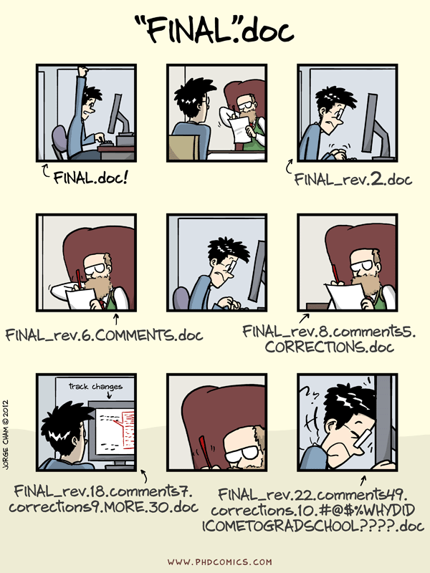
Source: http://www.phdcomics.com/comics/archive/phd101212s.gif
Notes:
Does this look familiar? Of course it does. We’ve all been subject, willingly and not, to this exercise.
You start off with good intentions, creating one document. But you need feedback, you have collaborators, or at some point you want to try out a new idea and make a copy of your document with that name.
Automated version control can get you out of this situation by letting us work on the same file but create unique versions in which only the changes are stored. We’ll get into this more in a bit. But first you might be saying to yourself, but these idiots should have been using Microsoft track changes!
Well, Microsoft Word does have track changes, but that’s just for Word documents, and I’ve seen plenty of examples where track change documents still get renamed by people. Google Docs does indeed have version history, but, again, you’re in a single silo’d context of Google Docs.
A version control system is file agnostic.
So, let’s take a closer look at how version control systems handle changes
Next slide ->

Slide 4
What is Version Control?
Keeping track of file changes can be hard
i.e. Thesis_v3_changed.docx, Thesis_v4.docx, Thesis_final.docx, Thesis_final_v2.docx etc…
Having tons of files of the same thing can become cumbersome if you want to know changes between versions
One directory with 1000 changed documents
Maybe you want to revert to an old version?
What if there was something that would keep track of the version of the document (regardless of what document it is?)

Slide 5
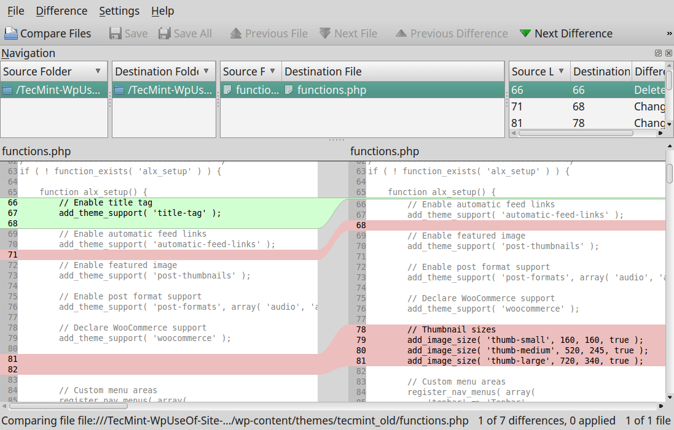
Meet git
Created by Linus Torvalds in 2005 (creator of Linux)
Started as a way to keep track of the Linux kernel (but can be used for any project)
“I'm an egotistical bastard, and I name all my projects after myself. First 'Linux', now 'git'”
Git being British slang for unpleasant person
Git works by keeping track of files in a repository (fancy name for your folder with your work in it)
And having a folder called .git that keeps track of branches, changes, adds and commits

Slide 6
v3_changed
ebc3e79
v4
fcc43f9
Thesis
final
f48hjft
final_v2
ebc83f3e
Each version of a file is given some “name”
- Instead of “v3_changed” it’s just some name that a computer understands better

Slide 7
Adding/Committing
Let’s say you’re working on your thesis, version “v3_changed” (but remember, git will call it something else)
You make a change, save the file, the file gets saved on your hard drive.
Git makes these steps manual ones and adds on in between, but they provide a way to keep track of changes as well as open up possibilities for more advanced and helpful techniques.
Change
Save
Hard Drive
git add
git push
git commit

Slide 8
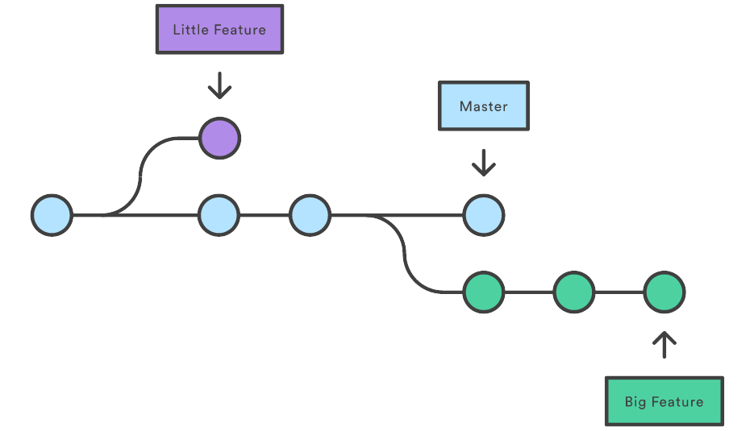
Branching
Ideas are sometimes made up of different flows
You want to try something new and see if it goes somewhere, without affecting the integrity of your already existing body work.
Same as Thesis_v4_newidea.docx
This type of thinking is called branching in git
You can create a branch, work on stuff, save it and it’ll be saved in the BRANCH, not in your original work (in git called the master branch).
When you’re ready, you can then add the file you changed to be committed, and then push that up to the repository to become a new version of the work
If the idea had legs, you can then merge that branch into your master branch.

Slide 9
v3_changed
ebc3e79
v4
fcc43f9
Thesis (master)
final
f48hjft
final_v2
ebc83f3e
Thesis
(new idea)
v1
ebc3ter6349
v2
2304uf8u

Slide 10
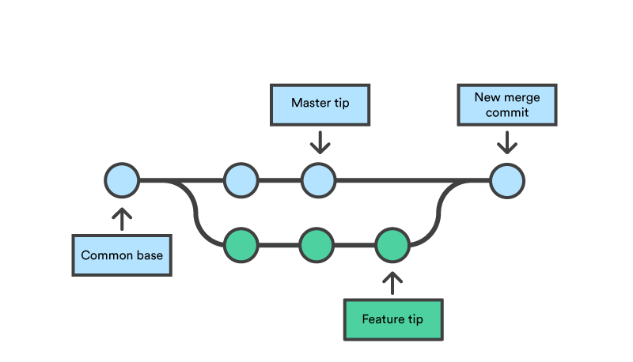
Merging Branches
Suppose you worked on your new_idea and now you want it to be part of your main body, in your master branch
Git allows you to merge those two branches and it will keep track of conflicts (that it will complain about).
Suppose right now, there are no conflicts and everything should go smoothly.
Checkout to the branch you want to be merged INTO (so if you want everything to be in master, checkout there)
Make sure you have the latest master branch
Git merge new_idea
Profit!

Slide 11
Basic Workflow for a single Researcher
Make a branch (or work in the master branch) (git checkout branch)
Make changes to your files (analysis, cleaning, regression, anything you want)
Git add the files you want to be committed
Git commit those files with a message so you have a shorthand of knowing what changed
Git push either to GitHub or to a local repository
Optionally merge a branch into master

Slide 12
Brief Glossary
Git – The Stupid Version Control System
GitHub – A server/cloud (whatever) where you can store repositories
Either privately or publicly
Version Control - A tool for managing changes to a set of files. Each set of changes creates a new commit of the files; the version control system allows users to recover old commits reliably, and helps manage conflicting changes made by different users.
Commit - To record the current state of a set of files (a change set) in a version control repository
Repository - A storage area where a version control system stores the full history of commits of a project and information about who changed what, when.
Merge - To reconcile two sets of changes to a repository
Fork – Taking an already existing repository and making it your own.
Notes:
That was a lot!
Ok, so to circle back before we start on the command line, I always find it helpful to make sure we’re all speaking the same language. Everyone is used to coming into a new environment where people are using crazy acronyms and terms that are highly domain specific. I mean we work in a Library for god sakes. So, here are some terms and definitions we’re going to use going forward.
A version control system is a tool that keeps track of these changes for us and helps us version and merge our files. It allows you to decide which changes make up the next version, called a commit, and keeps useful metadata about them. The complete history of commits for a particular project and their metadata make up a repository. Repositories can be kept in sync across different computers facilitating collaboration among different people.
Questions?
Next slide ->

Slide 13
Getting Started
Here are two common ways to start a project and use git for version control.
Fork an existing GitHub project and clone it to your local system.
Create a local git repository.
Let’s try them both out!
Notes:
Both examples will be based on the TIER Documentation Protocol. This protocol provides a template for assembling the code, data, and documentation that comprise an empirical research project. Learn more about it at https://www.haverford.edu/project-tier/protocol-v2.
A GitHub repository is available at https://github.com/ProjectTIER/ProjectTIER_R.
Back to slides (Setting up Git) ->

Slide 14
Forking and Cloning a GitHub project
Log in to your GitHub account.
Navigate to https://github.com/lordflaron/Experimetrics-BITSS-Workshop
Click the Fork button (upper right corner of the page)
Wait for the project to fork to your Github account
Click the Settings button and rename the project.
Use the Download or Clone button and copy the clone link.
Open a shell e.g. Terminal in MacOSX or Git-bash in Windows and give this command:
git clone https://github.com/YOUR_ACCOUNT/YOUR_PROJECT.git
Notes:
The GitHub interface also allows the creation of teams for collaborative development. A detailed explanation of the mechanics of collaboration is outside the scope of this tutorial, but is well documented in various sources.

Slide 15
Committing a Change
Use cd to navigate to your project folder:
cd YOUR_PROJECT
Edit the file called README.md (use nano, notepad, etc.) to replace the content with the following text:
# My First Commit
Then give these commands to commit your change:
git add README.md
git commit -m “Modified project readme file”

Slide 16
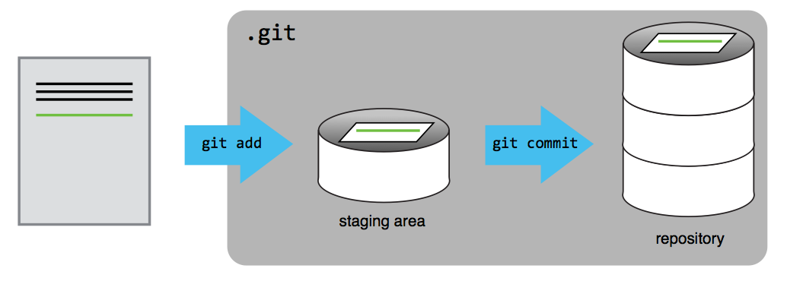
Git Staging Area
Notes:
You might think it’s a bit annoying to have to add your changes to a staging area, then commit them
A commit represents a set of work, changes/additions/deletions of one to many files.
Many times, you might find yourself touching several files as part of a change. Maybe you update a script and the documentation in a README, for example.
Add files as you work on this, then when everything is ready, you can review (using our favorite git status) and then commit
Shopping cart metaphor. Your staging area is the shopping cart. You walk the aisles in the store and grab what you need for the dinner you’re making tonight. But at the end of all that shopping, you checkout once for everything
Also lets you catch mistakes and fix them, or make additional changes, before you commit
Let’s look at another example with multiple files (next slide)

Slide 17
Pushing to GitHub
You can commit your change to GitHub using this command.
git push origin
(You’ll need to authenticate in order to push to GitHub)
Check GitHub to see your change!

Slide 18

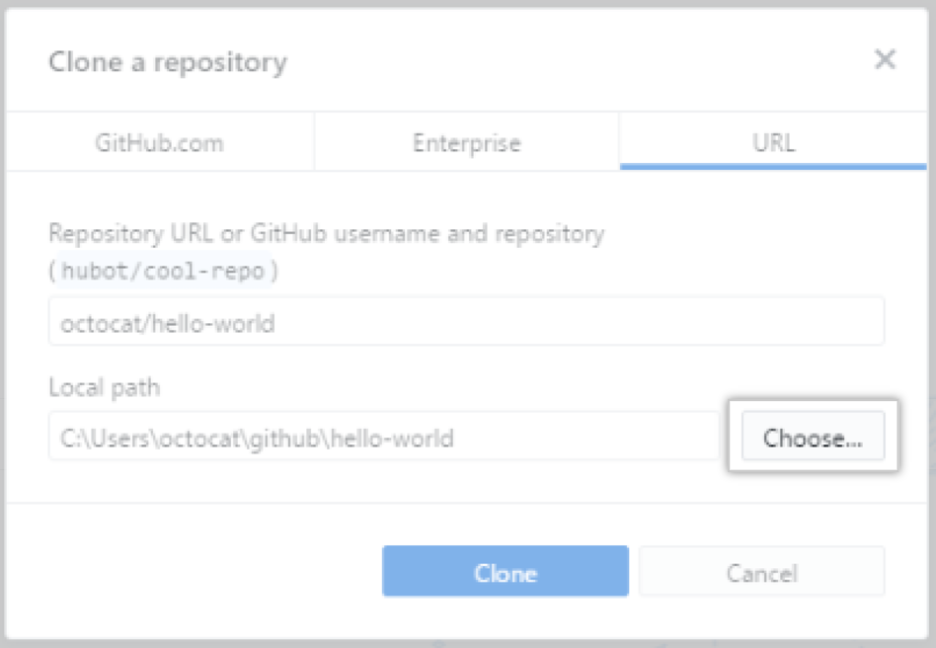
Using the Desktop Application (Cloning a Remote Repository)
Find the page of the repository
Click Open in Desktop
Choose the location of where it should be cloned.

Slide 19
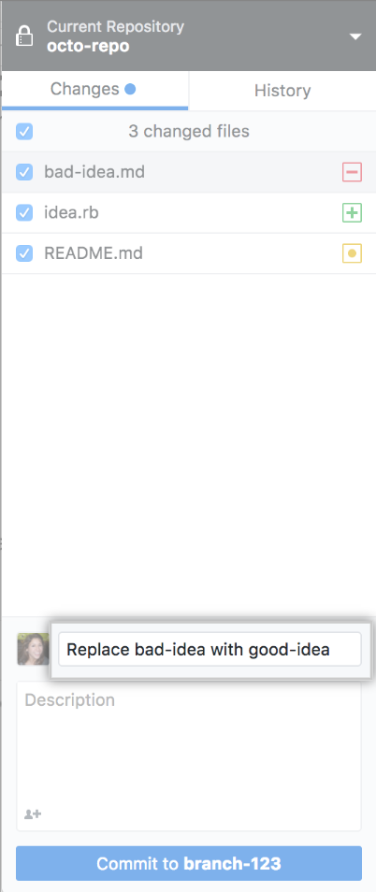
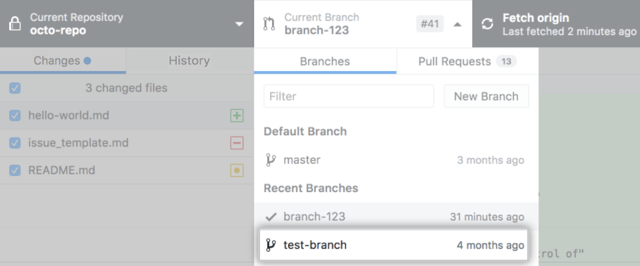
Using the Desktop Application (Committing Changes)
First choose the branch you want to make changes in
Make necessary changes
Choose which files to add
Write a commit message
Commit!
Click Push Origin to push changes

Slide 20
Git merge, collaboration and merge conflicts
You can also collaborate on git with other researchers
This helps if you’re working on a platform with limited tracked changes (COUGH COUGH latex), or do-files.
Each collaborator can work on their own branch and then submit a pull request to merge into the master branch. Each pull request provides an opportunity for checking working as well as discussion of changes.
If a merge causes conflicts, git will complain and will tell you to resolve them before merging again.

Slide 21
Using the Desktop Application (Merging and Merge Conflicts)
Merge Conflicts occur when there are committed changes to two branches that are different from each other.
Now that we have pushed a change to our master branch, let’s make a new brach and create a conflict to see how git reacts.
Click File → New Branch
Call it MergeConflict
Now all changes will be committed to the new branch, not master.
Make a change to README.md from before.
Add or change it in anyway you want.
Add and commit changes
Go back to master branch
Change README.md again in a different way
Commit changes
Now try to git merge them.
The application shows you the conflict, which must be resolved in order for the merge to take place
Once it is resolved, another commit will finish the merge.

Slide 22
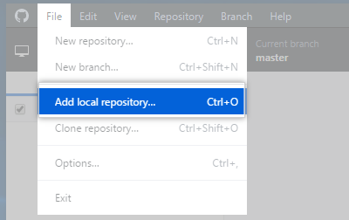
Using the Desktop Application (Adding a local Repository)
To make thing a little easier, there is also a Github Desktop Application available.
Open up the desktop application
Go to File → Add Local repository
Click Choose, Find the folder of the repository
Click Add Repository

Slide 23
Create a Local Repository
It’s also possible to create a local repository from the command line. Let’s build a TIER Project from scratch (be sure to navigate out of the project directory you just created):
mkdir MyProject
cd MyProject
echo “#My Project” >> README.md

Slide 24
Initialize and Commit to git
We’ll create the default README file and.
git init
git add .
git commit -m “Initial commit”
If you choose to do so, you may push the project to GitHub. You’ll need to create an new, empty repository on GitHub, copy the url, then run these commands:
git remote add origin REMOTE_REPO_URL
git push -u origin master

